Slide 1


Scientific Machine Learning
Lecture 11: PINN for PDE problems
孟旭辉
数学与统计学院数学与应用学科交叉创新研究院
办公室：欣苑2栋111室
Email：xuhui_meng@hust.edu.cn
https://github.com/XuhuiM/SciML-Course
5/10/2024

Slide 2
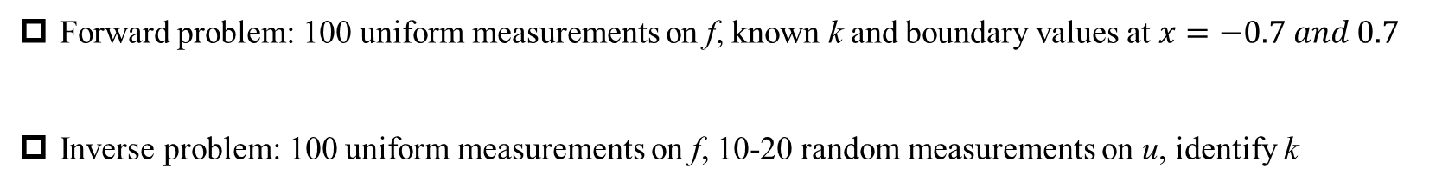

第二次作业
$$∂_{x}^{2}u+ktanh\left(u\right)=f, x∈\left[−0.7, 0.7\right]$$
$$u\left(x\right)=\sin^{3}\left(6x\right);k=0.7$$
$$f=0.18\left(12\sin\left(6x\right){\cos\left(6x\right)}^{2}−6{\sin\left(6x\right)}^{3}\right)+0.7tanh⁡(u)$$
Forward problem: 100 uniform measurements on f, known k and boundary values at $x=−0.7 and 0.7$
Inverse problem: 100 uniform measurements on f, 10-20 random measurements on u, identify k

Slide 3
Contents
An alphabet of PINNs – an overview
Gradient-enhanced PINNs: gPINNs
Conservative PINNs via domain decomposition: cPINNs
Extended PINNs via domain decomposition: xPINNs
PINNs for fractional PDEs: fPINNs
PINNs for stochastic PDEs: sPINNs
Summary
References
Notes:
We will first describe some of the different versions of PINNs and then we will highlight a few of them for diverse applications with domain decomposition, for conservation laws, as well as
Fractional and stochastic PDEs

Slide 4
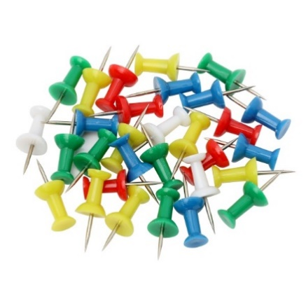
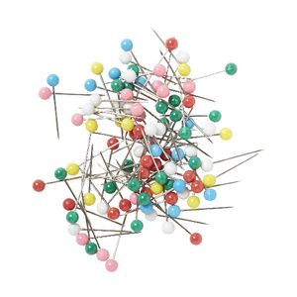

An Alphabet of PINNs aper in Nature Physics Reviews, June 2021)
vPINNs/hp-vPINNs: variational PINNs (Lecture 9)
gPINNs: gradient-enhanced PINNs
cPINNs: conservative PINNs
xPINNs: eXtended PINNs
fPINNs: fractional PINNs
sPINNs: stochastic PINNs
BPINNs: Bayesian PINNs (Lecture 12)
…
Notes:
This is just a small sample of what is published in the literature so far.

Slide 5
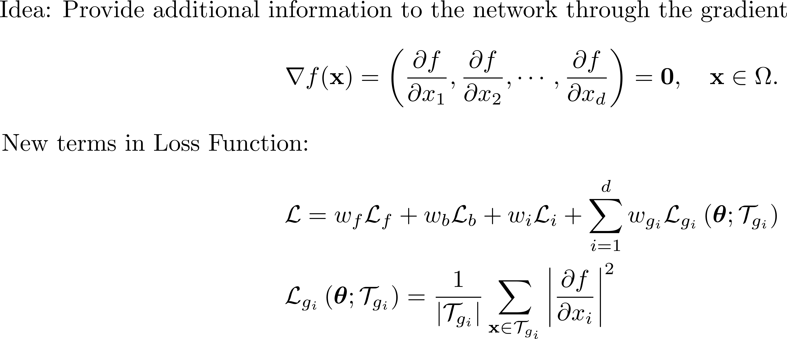
gPINNS: gradient-enhanced PINNs
Yu J, Lu L, Meng X, Karniadakis GE. Gradient-enhanced physics-informed neural networks for forward and inverse PDE problems. Computer Methods in Applied Mechanics and Engineering. 2022 Apr 1;393:114823.
Notes:
In gPINNs we modify the loss function to include the gradient of the residual.

Slide 6
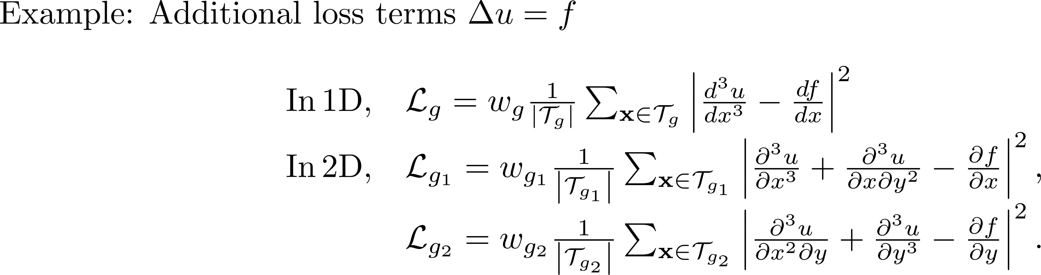
gPINNS
Notes:
Here we present two simple examples in 1D and 2D; for the gradients we will use AD.

Slide 7
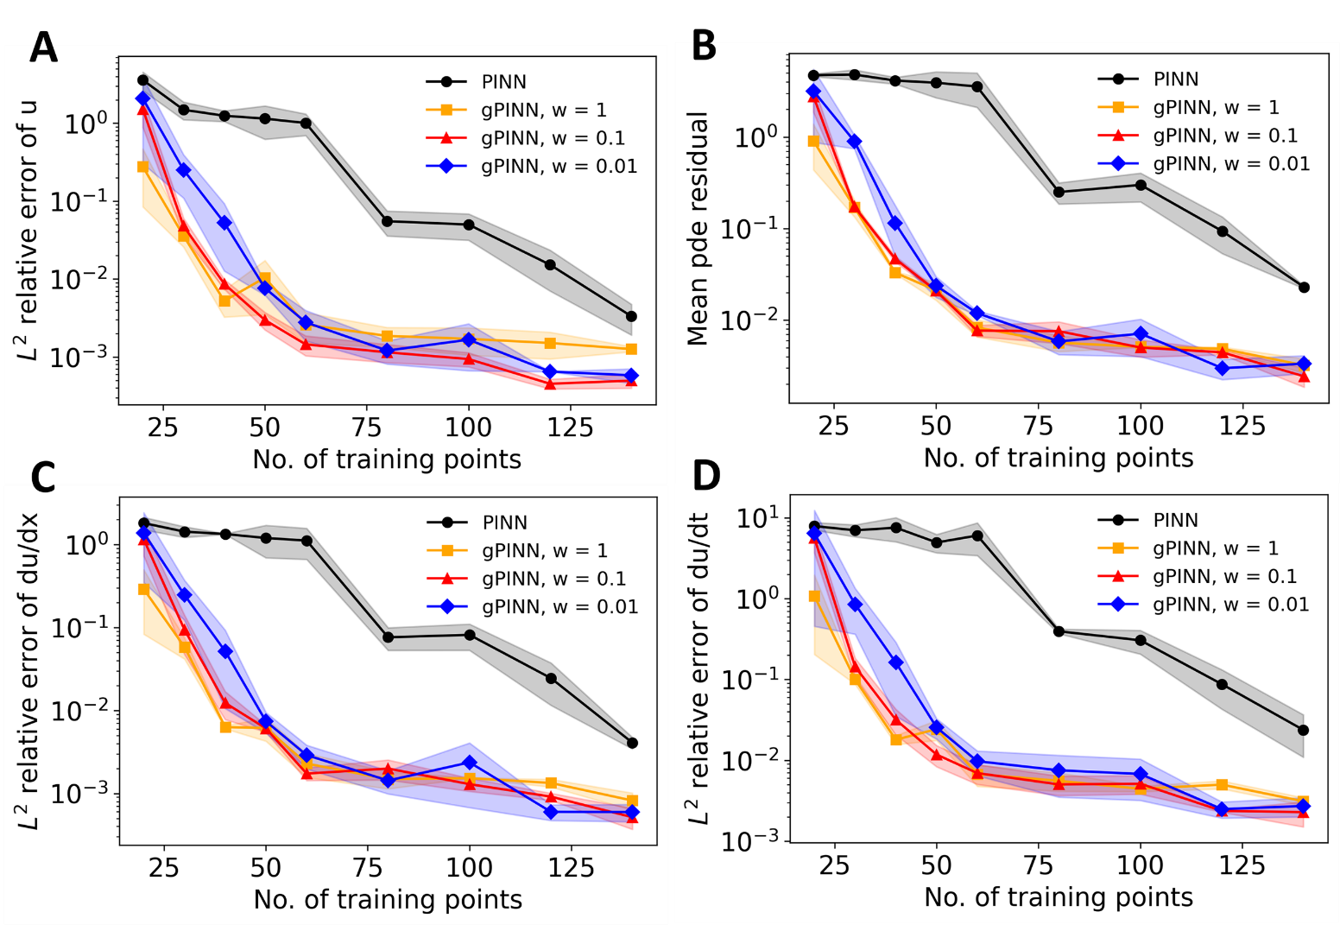
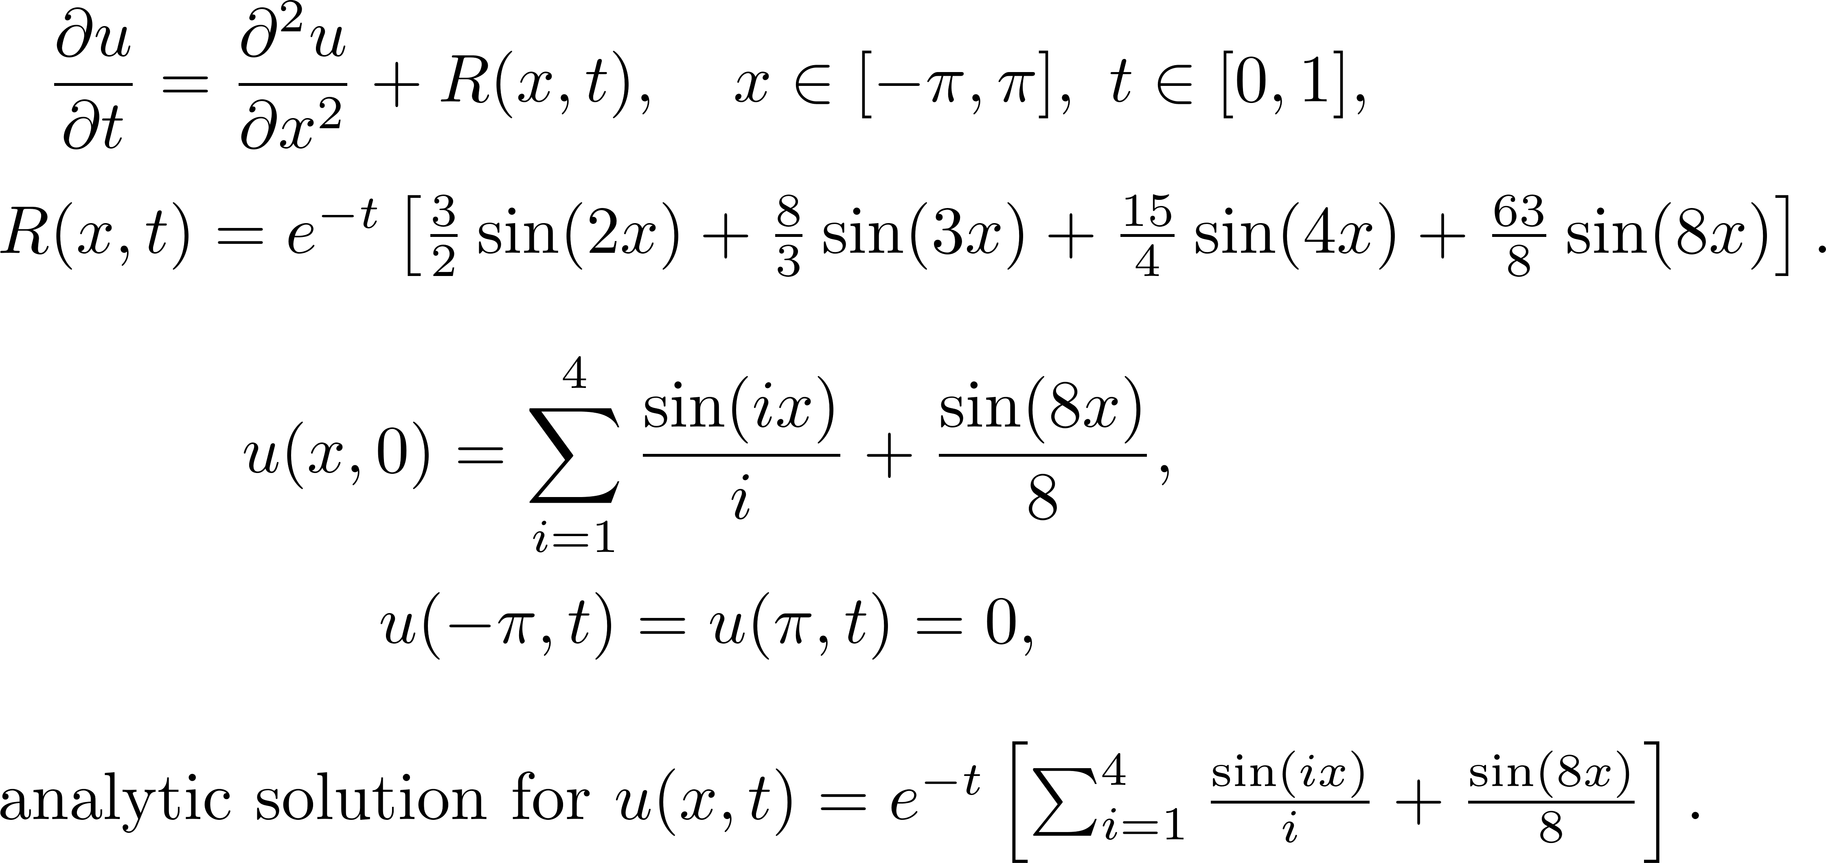
Diffusion Equation
Notes:
In this diffusion equation, gPINN converges much faster especially for a small number of training points compared to PINNs; Here w is the weight in front of the time and space gradients and for this case its pprecise values is not so important
But in general its value determines the final accuracy.

Slide 8
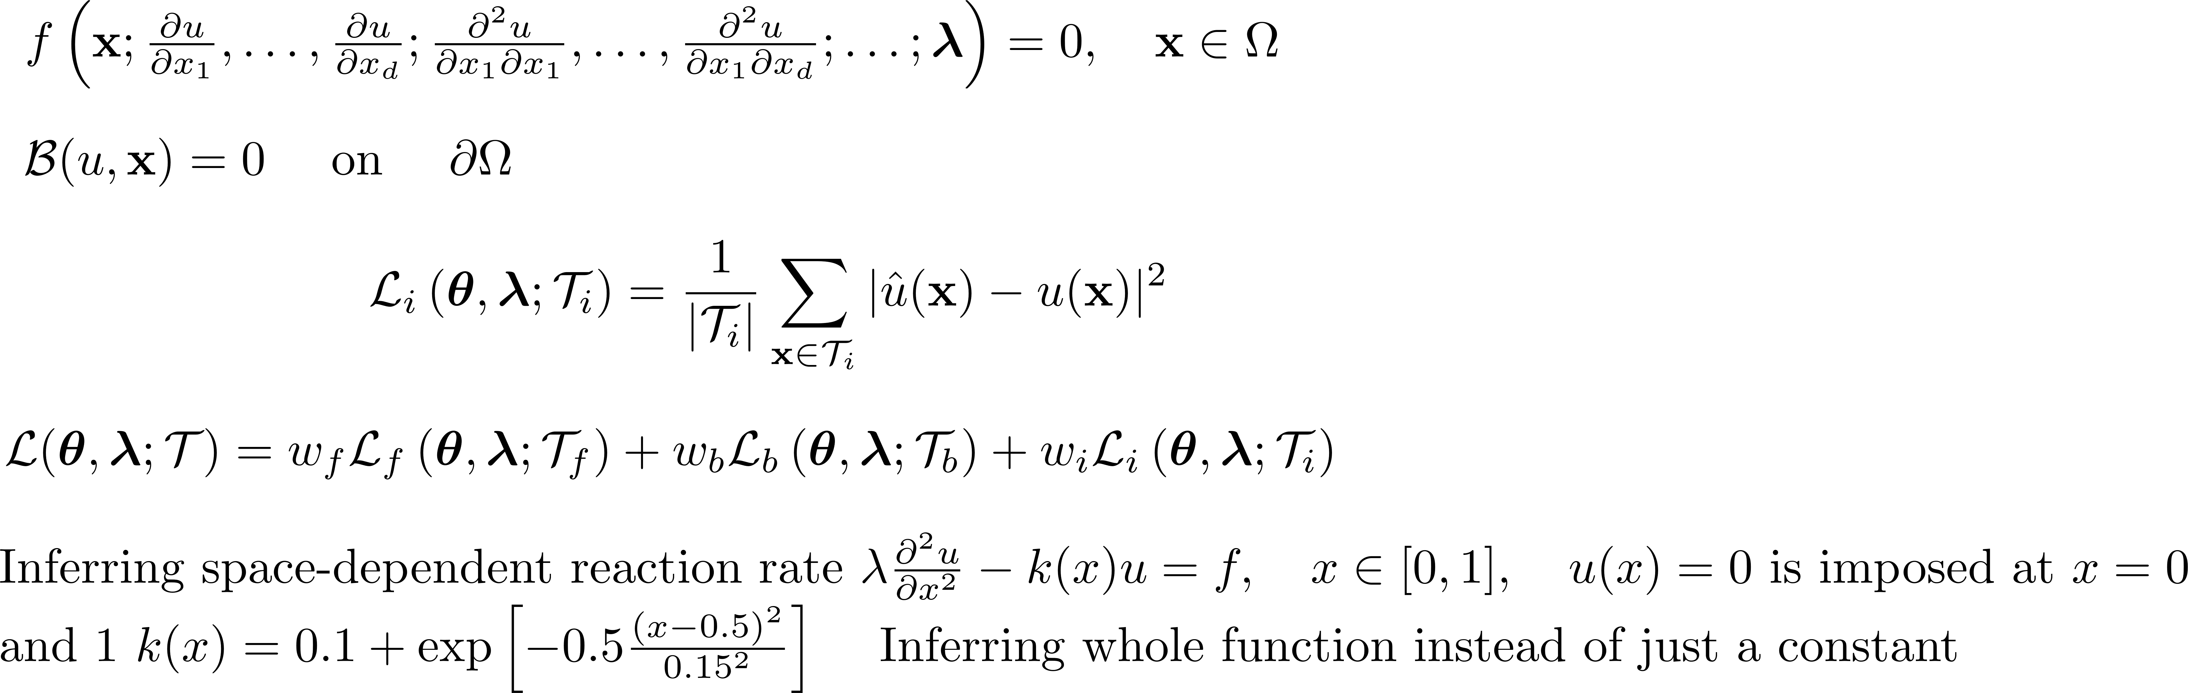
Inverse Problem
Notes:
In this inverse problem we use an extra NN to infer k(x), which is space dependent. Here the difference in the solution is not big but noticeable.

Slide 9
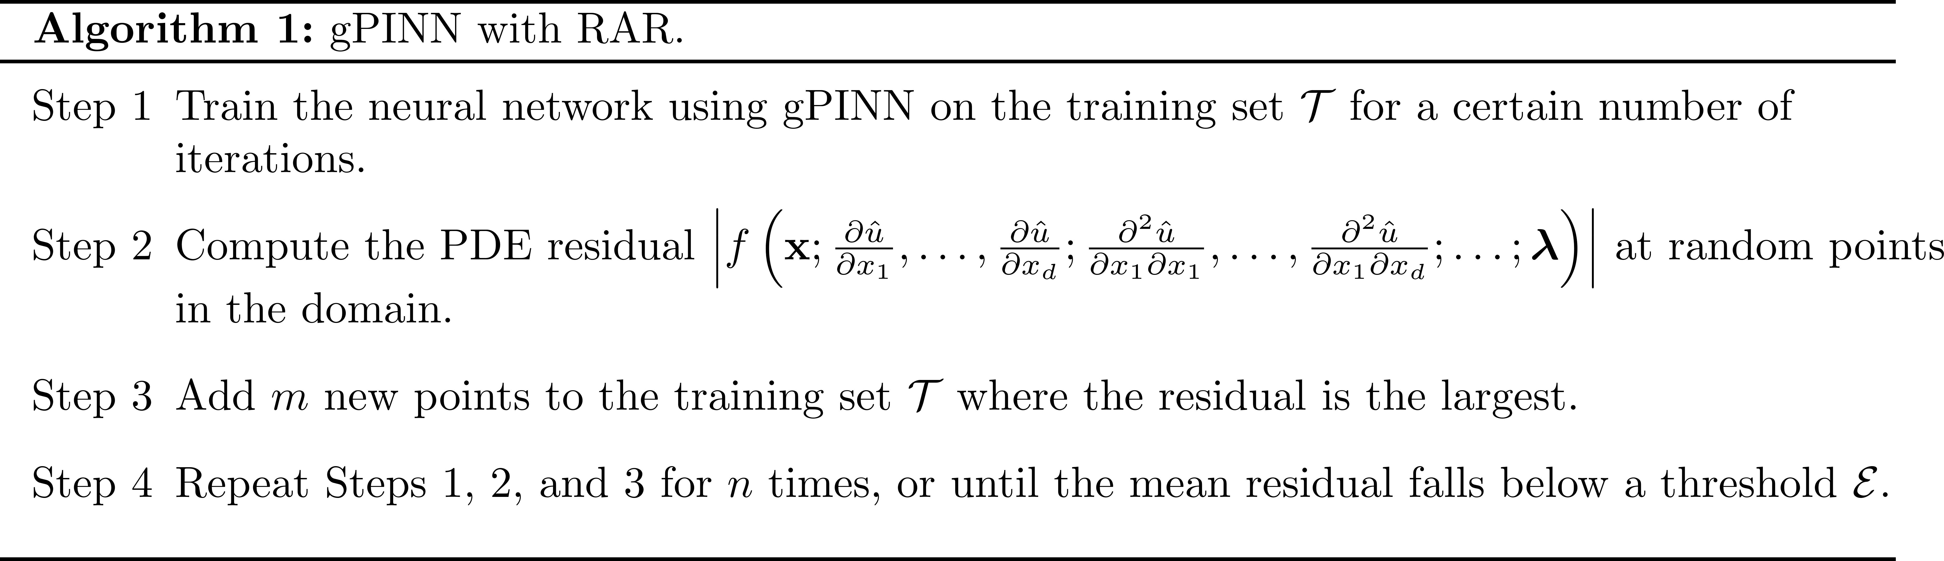
gPINNS with Residual Adaptive Refinement (RAR)
Notes:
A siimple algorithm for refinement is based on the residuals that we computer – RAR – and can be applied adaptively. The question of sampling and refinement is currently
Investigayed by several research groups and is particularly important for problems involvcing steep fronts and propagation, including phase fields.

Slide 10
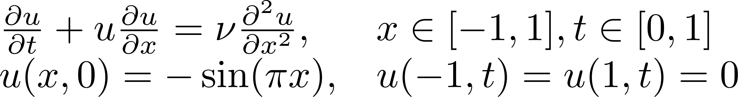
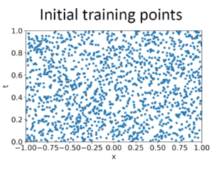
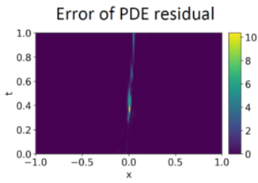
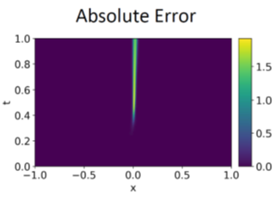
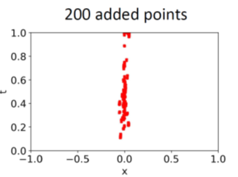
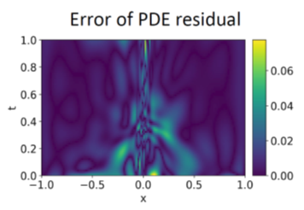
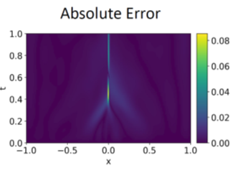
Burgers Equation
Notes:
For a nonlinear equation, we can use RAR to add 200 extra points resulting in enhanced accuracy where the steep front is cutting the error significantly.

Slide 11
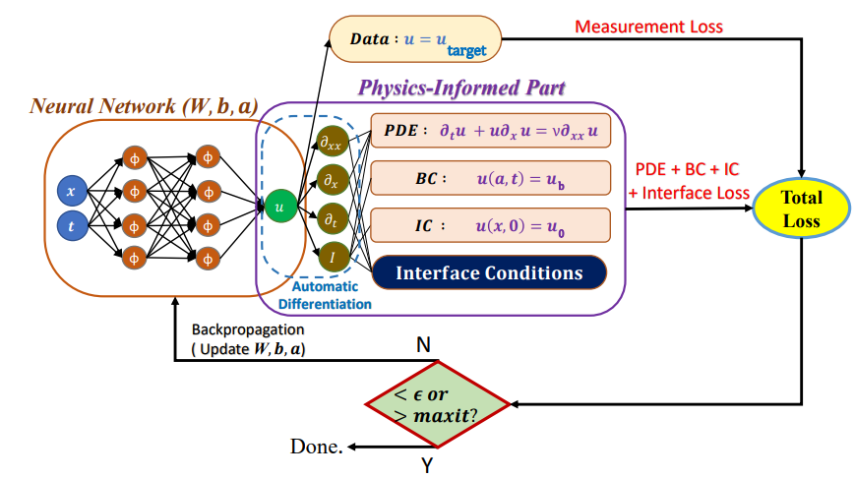
PINNs with Domain Decomposition
Notes:
PINNs can be scaled up by using ideas from Domain Decomposition in the solution of PDEs, e.g. FEM etc. We have already seen a variational example in Lecture 9 but here we
Consisder the classical PINN form.

Slide 12
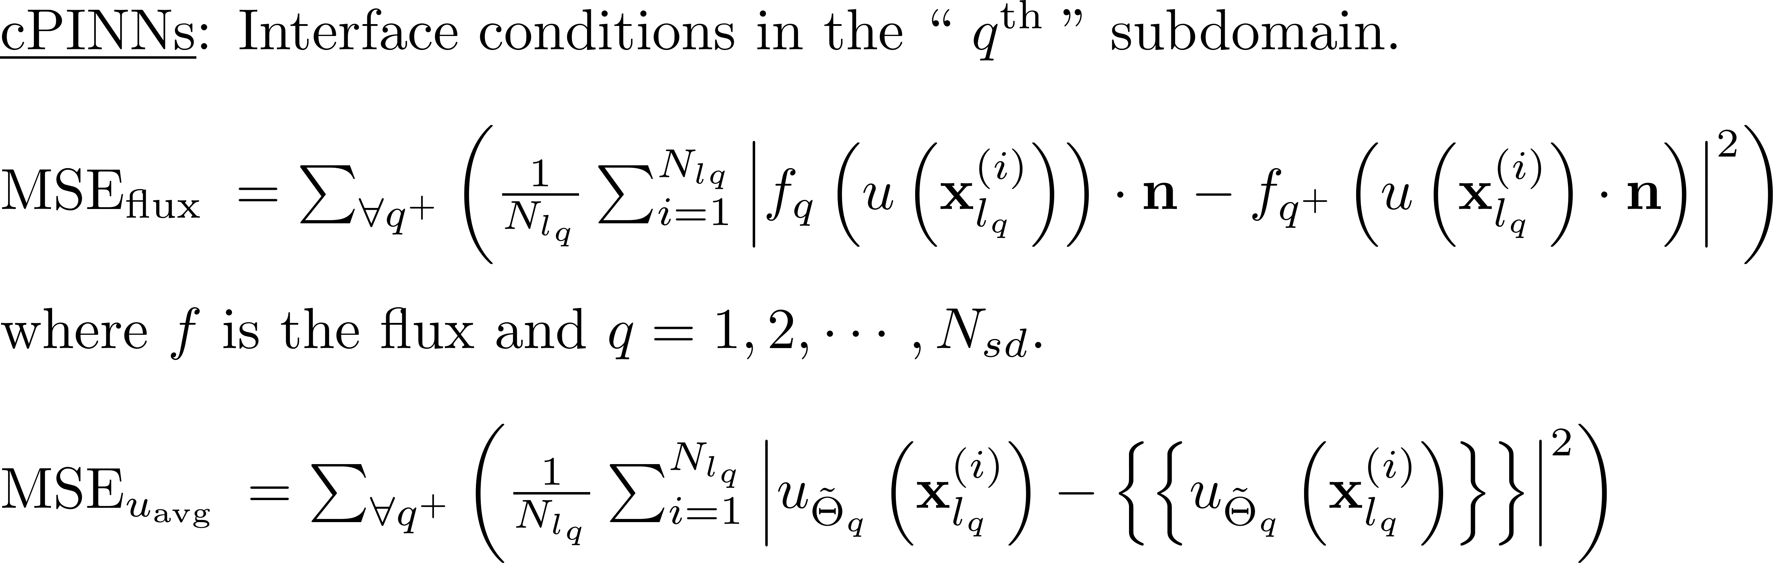
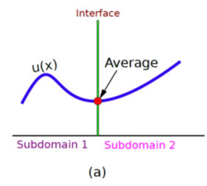
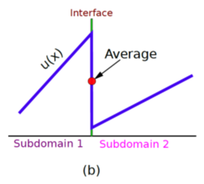
Conservative PINNs (cPINNs): Application to Conservation Laws
Jagtap AD, Kharazmi E, Karniadakis GE. Conservative physics-informed neural networks on discrete domains for conservation laws: Applications to forward and inverse problems. Computer Methods in Applied Mechanics and Engineering. 2020 Jun 15;365:113028
Notes:
For conservation laws, we can get inspiration from finite volumes using fluxes at the interfaces and hence derive proper interface conditions that will be added as extra loss terms in the total
Loss function. In addition, we penalize the solution at the interface. Mimicking DG methods.

Slide 13
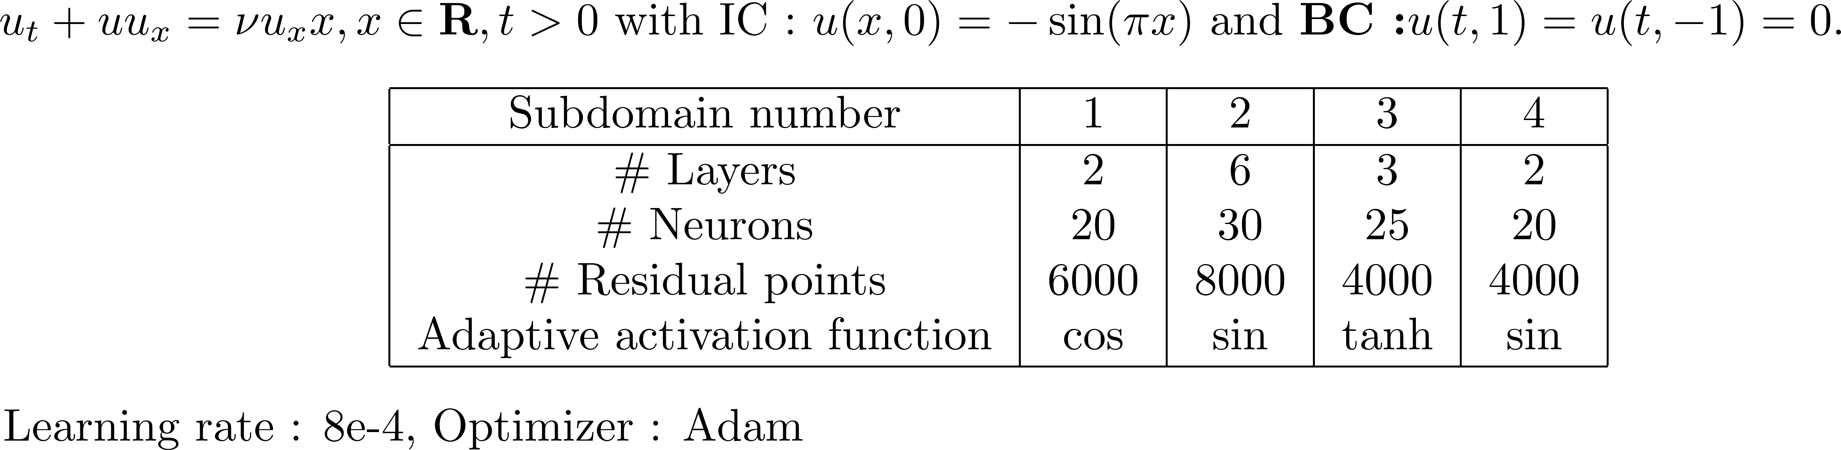
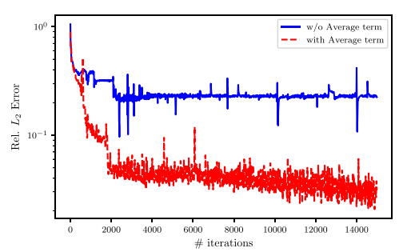
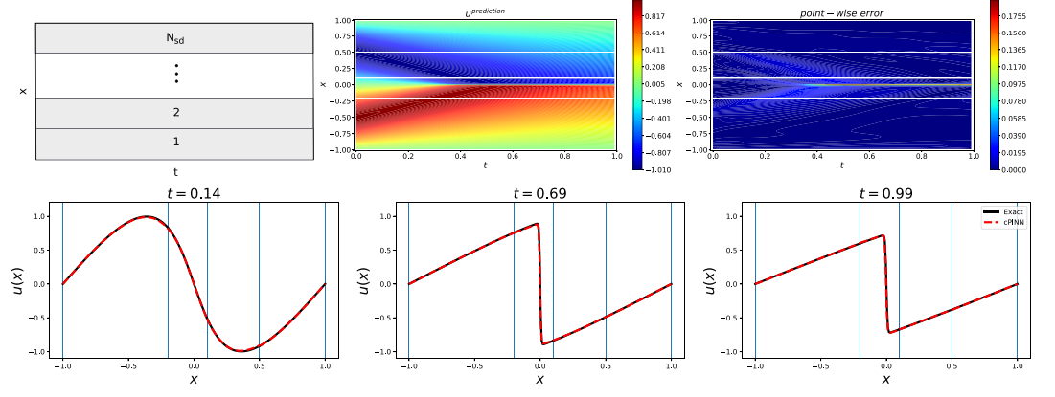
cPINN Results: Burgers Equation
Notes:
Let us consider again the Burgers equation – here we split the domain in space only in 4 elements. Note that we can assign different NN in every domain of different size and even different AF and this gives
Us great flexibility.

Slide 14
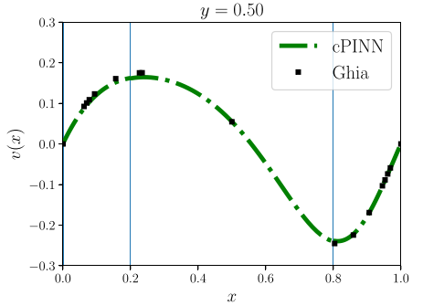
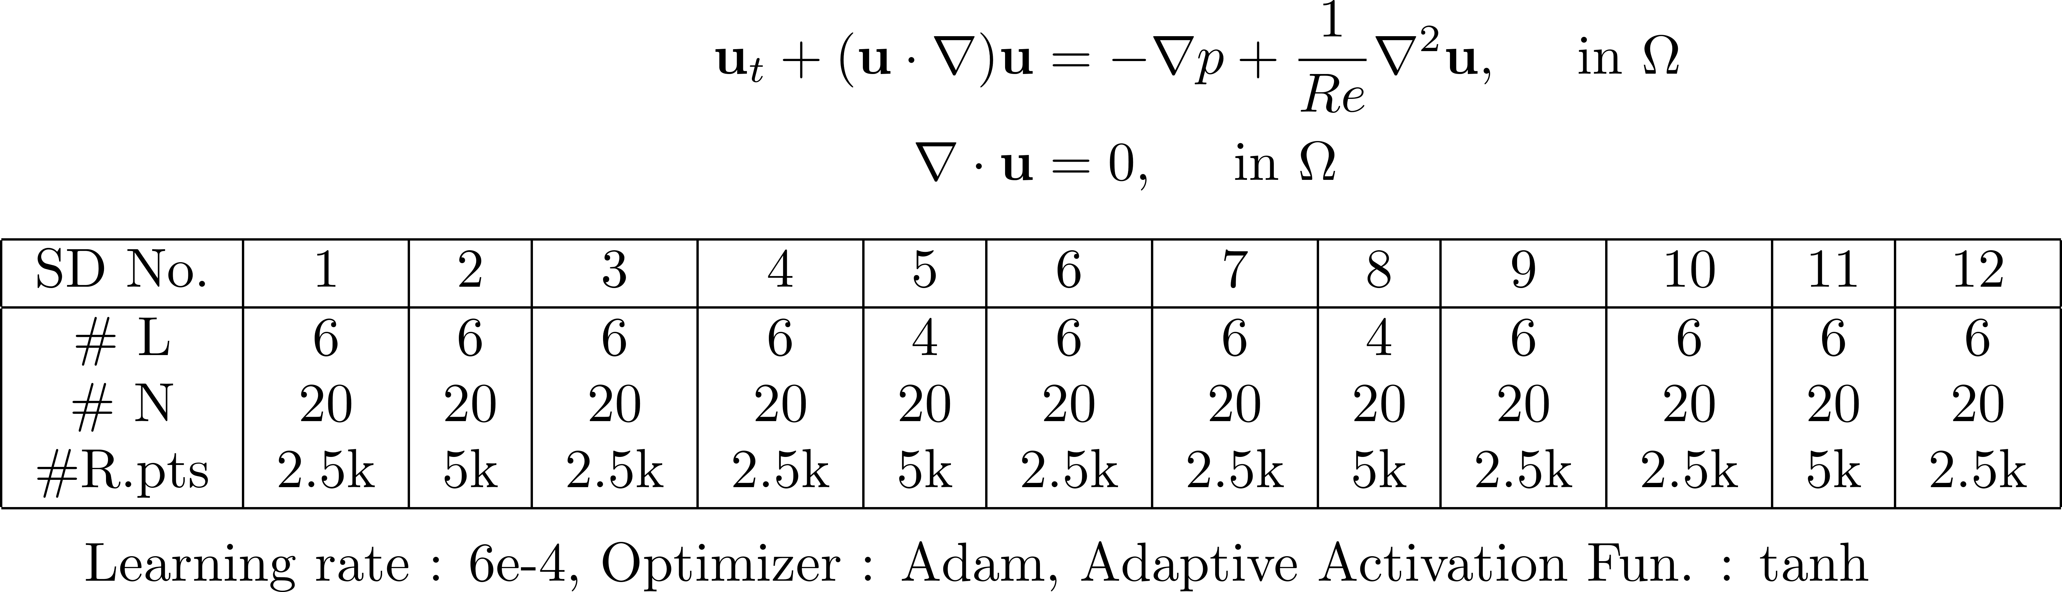
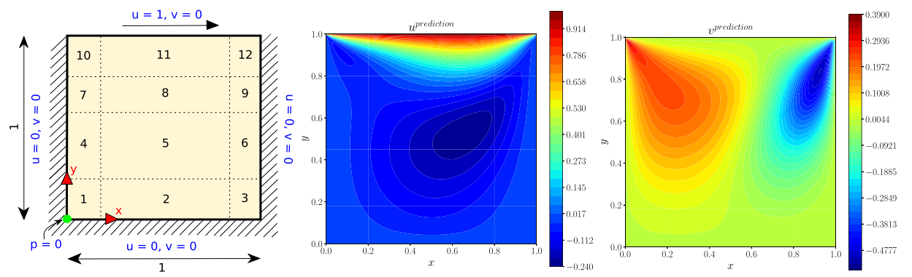
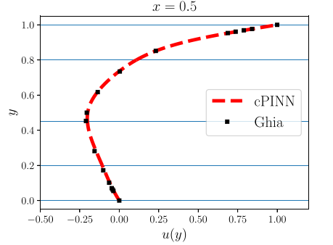
cPINN Results: 2D Incompressible Navier Stokes Equation
Notes:
Applying this to the standard cavity benchmark at Re=100, we can introduce 12 domains here with different architectures; the results are compared with benchmark solutions.

Slide 15
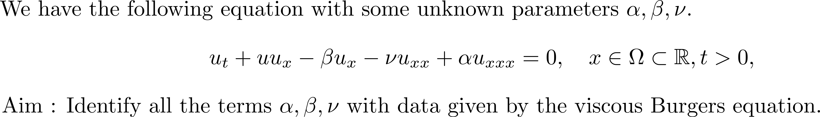
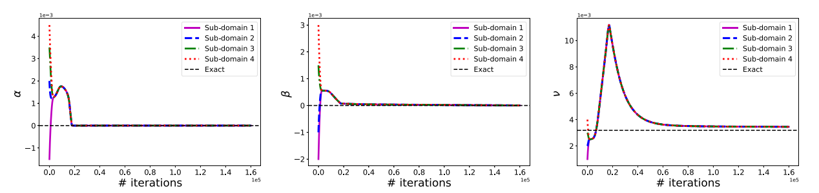
cPINN Results: Inverse 2D Burgers Equation
Notes:
We can also tackle the inverse Burgers to identify three parameters, shown here, and convergence seems ti be uniform across all domains.

Slide 16
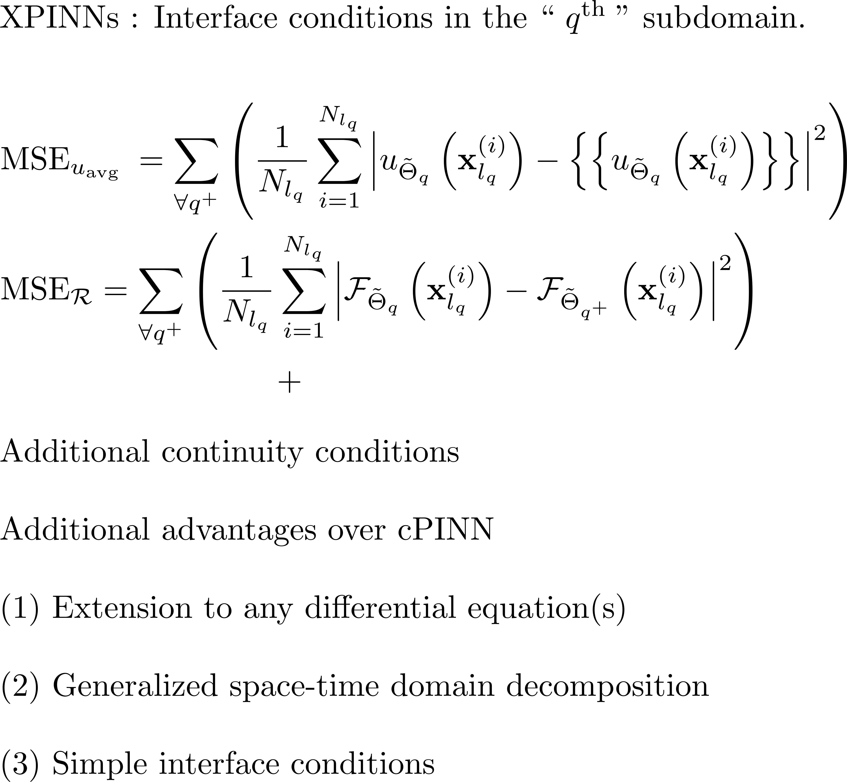

Extended PINNs (XPINNs)
Notes:
The XPINN is a generalization of CPINN as it can be applied to arbitrary PDEs. Here we can penalize the residual at the interface since we know its continuous and equals to zero.
We also impose the average velocity at the interface. This algorithm works but theoretically to prove convergence, we also need to impose the gradient at the interface that
Will make the algorithm more complicated. An alternative is to use the gPINN approach.

Slide 17
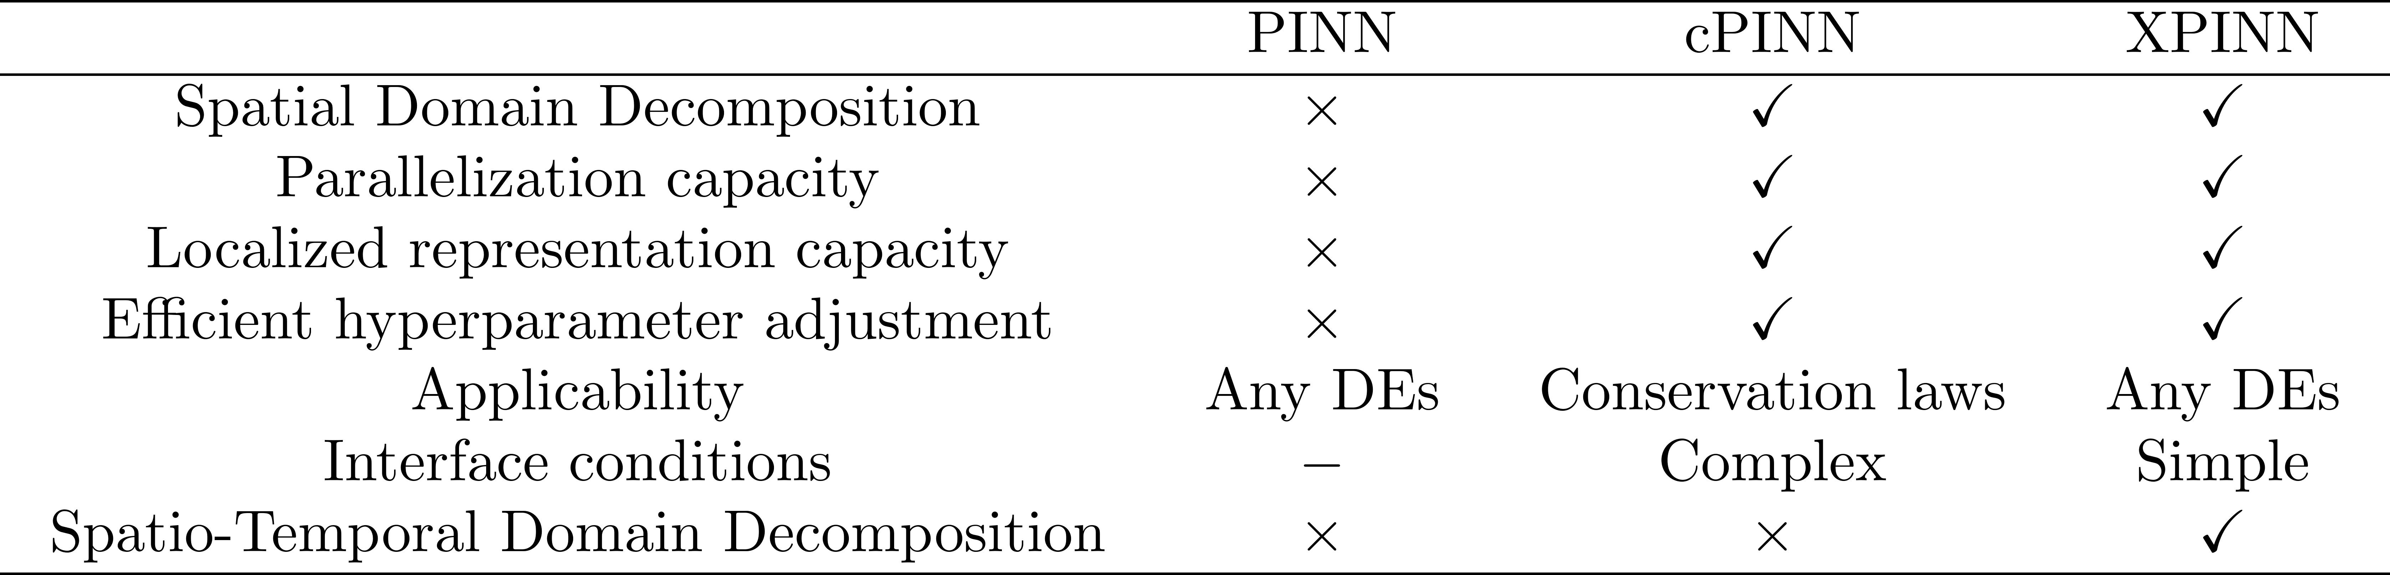
Comparison of PINN, cPINN and XPINN frameworks
Jagtap AD, Karniadakis GE. Extended physics-informed neural networks (xPINNs): A generalized space-time domain decomposition based deep learning framework for nonlinear partial differential equations. Communications in Computational Physics. 2020 Nov 1;28(5):2002-41.
Notes:
Here we summarize three versions of PINNs……

Slide 18
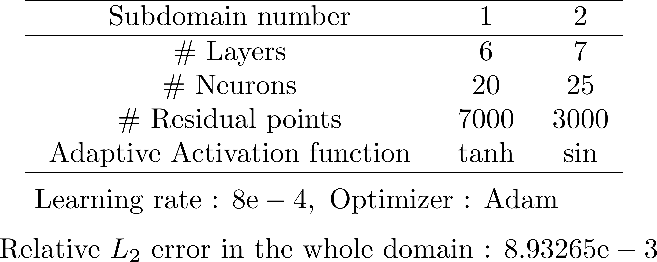
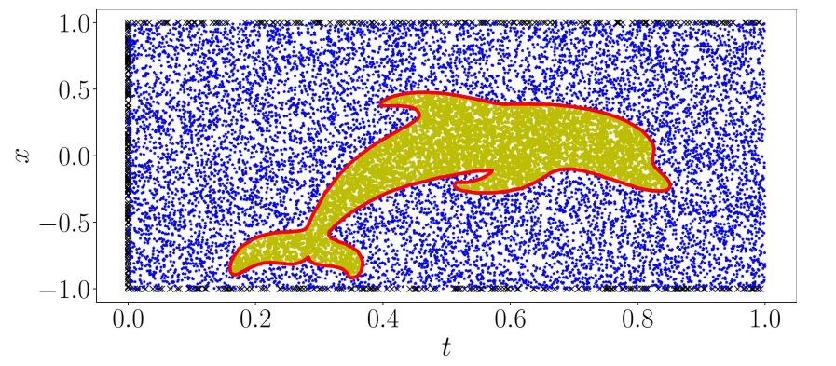
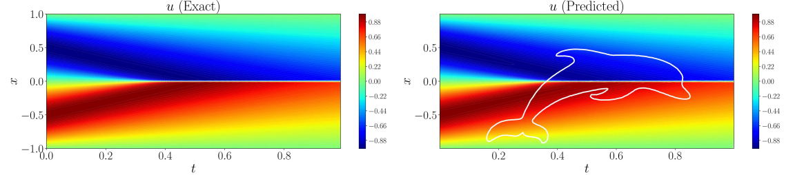
XPINN Results: Burgers Equation
Notes:
XPINN can provide decomposition in both space and time and hence we can achive parallelism in time that iis typically very hard to do in scientific computing. Note also that the
Domains can be of arbitrary shape unlike the convebtional methods.

Slide 19
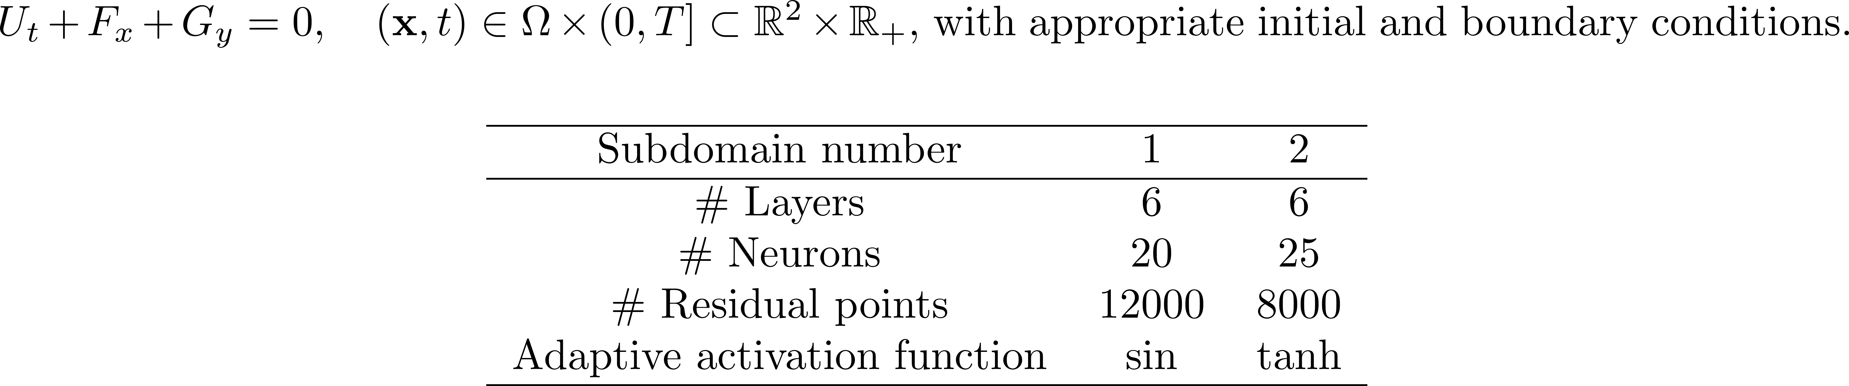
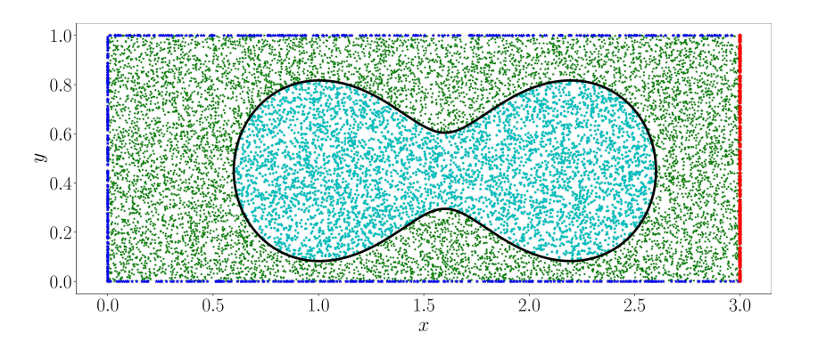
XPINN Results: 2D Compressible Euler Equations
Notes:
Another example of arbitrary decomposition is the peanut domain for the 2D steady Euler equations. Note again that we use different NNs and different AF in each domain.

Slide 20
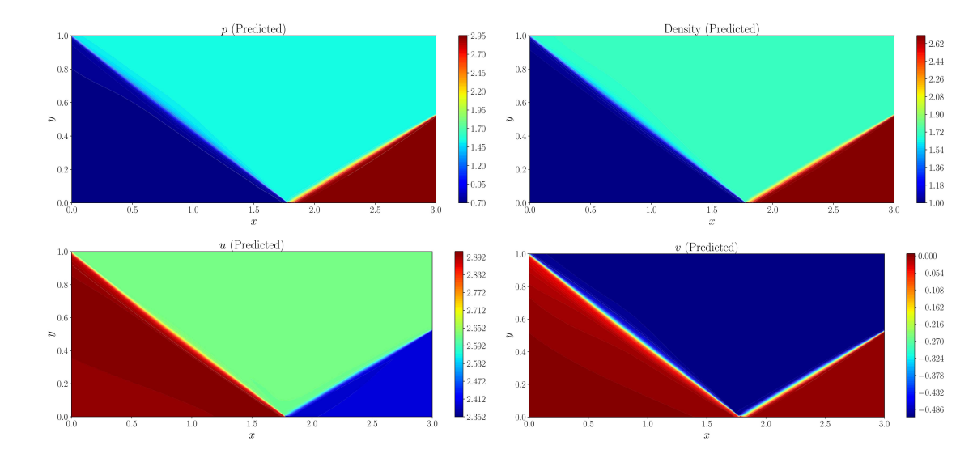
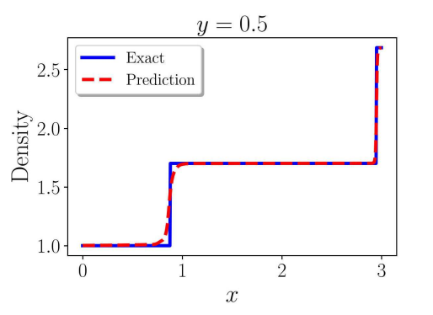
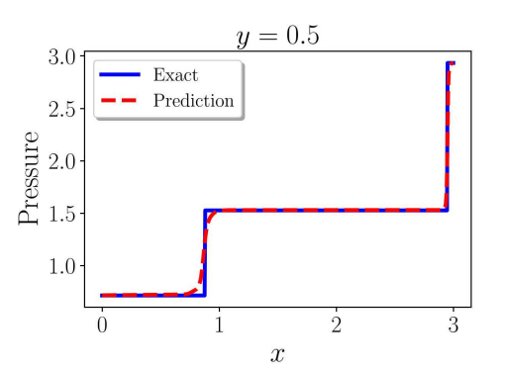
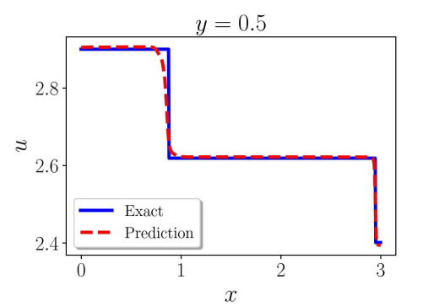
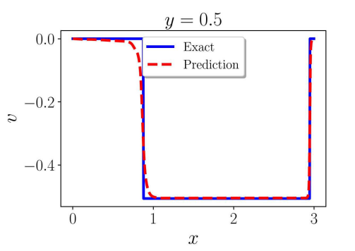
XPINN Results: 2D Compressible Euler Equations
Notes:
Despite the arbitrary decomposition, the solution is seamless across the interfaces.

Slide 21
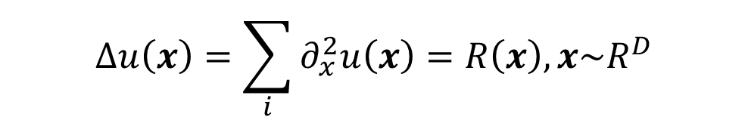
High-dimensional Poisson equation
$$Δu\left(x\right)=\sum_{i}{∂_{x}^{2}u\left(x\right)=R\left(x\right), x\sim R^{D}}$$
Memory usage:
The size of first layer ~ D
The number of second-order derivatives ~ D

Slide 22
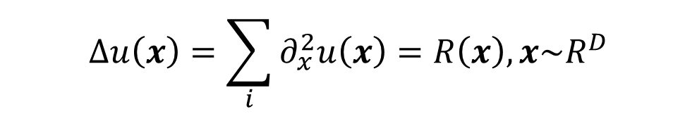
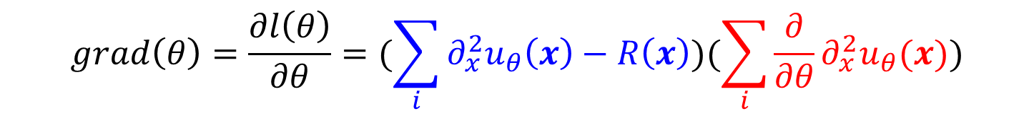
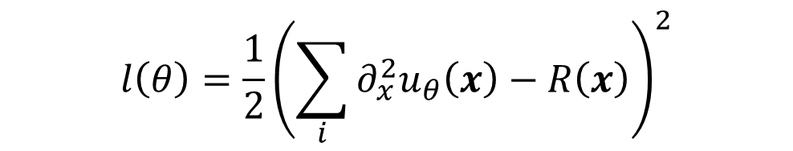
High-dimensional Poisson equation - Gradient descent
$$Δu\left(x\right)=\sum_{i}{∂_{x}^{2}u\left(x\right)=R\left(x\right), x\sim R^{D}}$$
$$l\left(θ\right)={\frac{1}{2}\left(\sum_{i}{∂_{x}^{2}u_{θ}\left(x\right)−R\left(x\right)}\right)}^{2}$$
$$grad\left(θ\right)=\frac{∂l\left(θ\right)}{∂θ}=(\sum_{i}{∂_{x}^{2}u_{θ}\left(x\right)−R\left(x\right)})(\sum_{i}{\frac{∂}{∂θ}∂_{x}^{2}u_{θ}(x)})$$

Slide 23
Tackling the curse of dimensionality with physics-informed neural networks
Neural Networks. (2024)
Zheyuan Hu, Khemraj Shukla, etc

Slide 24
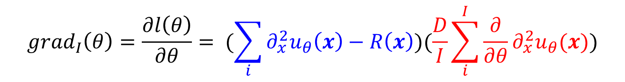
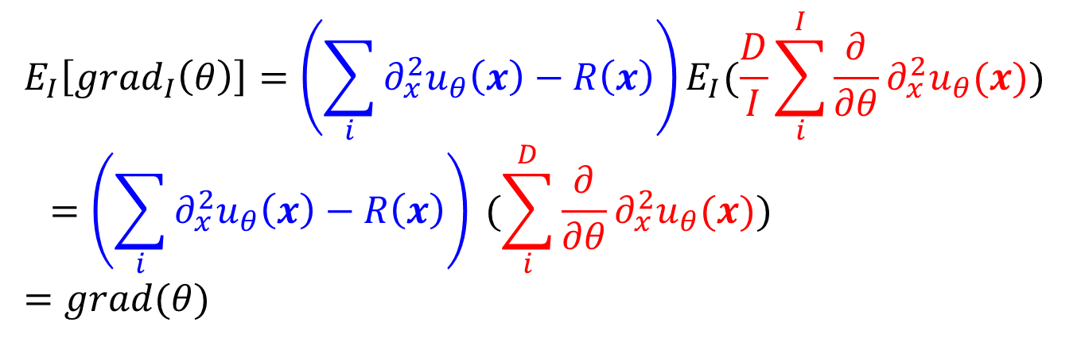
From SGD to SDGD
$$grad_{I}\left(θ\right)=\frac{∂l\left(θ\right)}{∂θ}= (\sum_{i}{∂_{x}^{2}u_{θ}\left(x\right)−R\left(x\right)})(\frac{D}{I}\sum_{i}^{I}{\frac{∂}{∂θ}∂_{x}^{2}u_{θ}(x}))$$
$$E_{I}\left[grad_{I}\left(θ\right)\right]=\left(\sum_{i}{∂_{x}^{2}u_{θ}\left(x\right)−R\left(x\right)}\right)E_{I}(\frac{D}{I}\sum_{i}^{I}{\frac{∂}{∂θ}∂_{x}^{2}u_{θ}(x})) \\ =\left(\sum_{i}{∂_{x}^{2}u_{θ}\left(x\right)−R\left(x\right)}\right) (\sum_{i}^{D}{\frac{∂}{∂θ}∂_{x}^{2}u_{θ}(x})) \\ =grad(θ)$$

Slide 25
From SGD to SDGD
$$grad_{I}\left(θ\right)=\frac{∂l\left(θ\right)}{∂θ}= (\sum_{i}{∂_{x}^{2}u_{θ}\left(x\right)−R\left(x\right)})(\frac{D}{I}\sum_{i}^{I}{\frac{∂}{∂θ}∂_{x}^{2}u_{θ}(x}))$$
$$E_{I}\left[grad_{I}\left(θ\right)\right]=\left(\sum_{i}{∂_{x}^{2}u_{θ}\left(x\right)−R\left(x\right)}\right)E_{I}(\frac{D}{I}\sum_{i}^{I}{\frac{∂}{∂θ}∂_{x}^{2}u_{θ}(x})) \\ =\left(\sum_{i}{∂_{x}^{2}u_{θ}\left(x\right)−R\left(x\right)}\right) (\sum_{i}^{D}{\frac{∂}{∂θ}∂_{x}^{2}u_{θ}(x})) \\ =grad(θ)$$

Slide 26
Numerical examples

Slide 27
Numerical examples

Slide 28

Thank you for your attention!

